Slide 1
North Bolivar Consolidated
School District

Slide 2
NBCSD Latest Initiatives
North Bolivar Consolidated School District continues to implement strategies and practices in an effort to create a safe, learning environment for our students and staff. These strategies and practices are implemented to slow the spread of the covid virus during this pandemic.
In addition to the use of desk shields, social distancing practices, cleaning and disinfecting, and the use of masks, we have decided to participate in the following:
District Covid 19 Weekly Testing Program
Home Test Option

Slide 3
District Covid 19 Weekly Testing Program
NBCSD will implement weekly school-based COVID-19 screening (testing) for students and staff.
Mississippi State Department of Health (MSDH)
The screening tests (BinaxNOW antigen tests) are rapid tests provided to the School District by MSDH that provide results within 15 minutes.
Shaw Medical Center
The molecular based tests or PCR provided by Shaw Medical Center, will be sent off and results are obtained within 48 hours.
There is no cost to you or your family for these screening tests but we need permission – Parental Consent Form.

Slide 4
Home Test Option
Mississippi Department of Health (MSDH) Home Test Option.
This option is to facilitate testing at day 5 of the quarantine period for exposed individuals prior to a return to the school setting.
MSDH has provided home test kits to our schools.
These home test kits will be sent home with students and school employees who have been exposed to COVID in the school setting and require a quarantine period.
Testing at day 5 of the quarantine period prior to a return to the school setting is another layer of protection and can lead to identifying cases prior to transmission occurring at the school.
North Bolivar Consolidated School District recommends a negative test for quarantined students and teachers prior to a return to school.

Slide 5
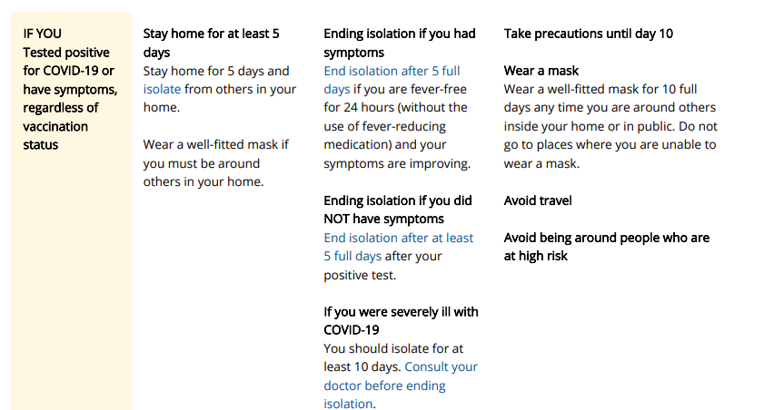

Slide 6
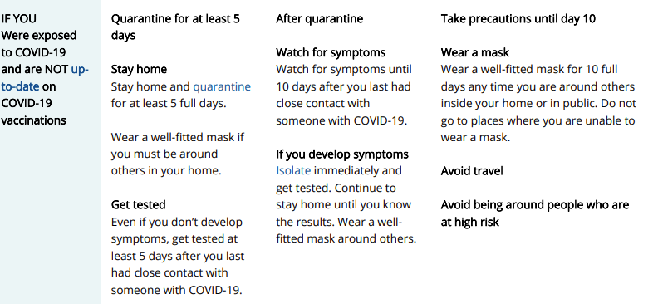
Calculating Quarantine
The date of your exposure is considered day 0. Day 1 is the first full day after your last contact with a person who has had COVID-19. Stay home and away from other people for at least 5 days.
Up to date means:
a person has received all recommended COVID-19 vaccines, including any booster dose(s) when eligible.

Slide 7
Calculating Quarantine
The date of your exposure is considered day 0. Day 1 is the first full day after your last contact with a person who has had COVID-19. Stay home and away from other people for at least 5 days.
Up to date means:
a person has received all recommended COVID-19 vaccines, including any booster dose(s) when eligible.

Slide 9
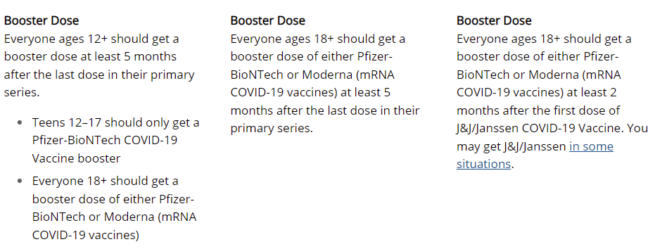

Slide 10
References
Quarantine and Isolation at https://www.cdc.gov/coronavirus/2019-ncov/your-health/quarantine-isolation.html
Stay Up to Date with Your Vaccines at https://www.cdc.gov/coronavirus/2019-ncov/vaccines/stay-up-to-date.html
Coronavirus Disease 2019 (COVID-19) at https://www.msdh.ms.gov/msdhsite/_static/14,0,420.html

